Slide 1


YOUR PADEL APP
The solution and service for an iOS and Android application to manage the Padel business provided by the customer to reserve courts and manage the users with their payments, with confirmations.

Slide 2


TODAY'S AGENDA
1
INTRODUCTION
2
FEATURES
3
TOOLS AND FRAM WORK
4
IIMPLEMENTATION STRUCTURE
5
APP DESIGN AND SOME FLOW

Slide 3
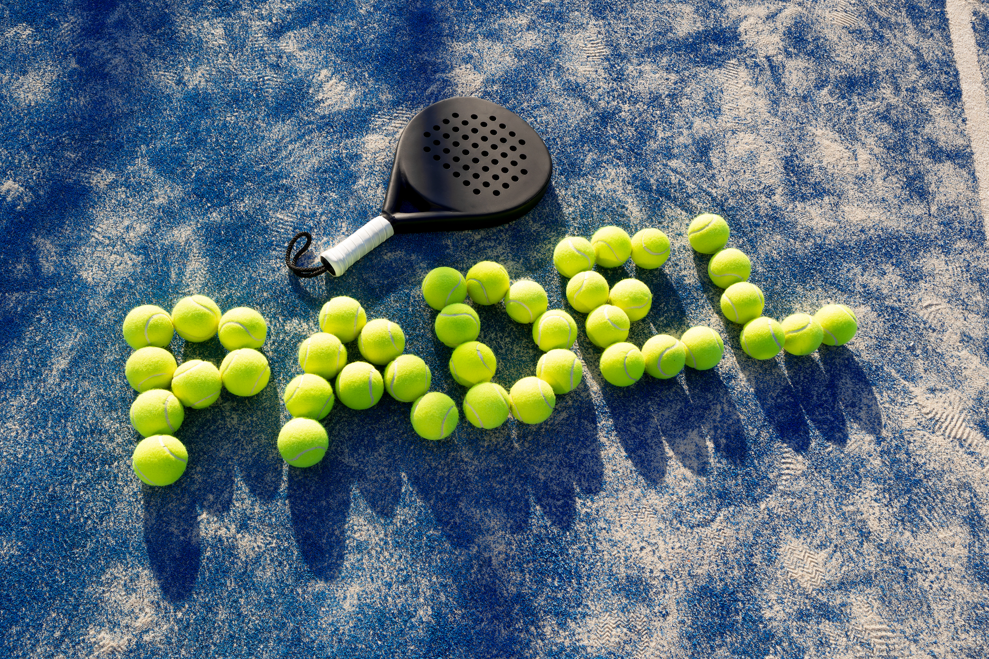
INTRODUCTION
The solution and service for an iOS and Android application to manage the Padel business provided by the customer to reserve courts and manage the users with their payments, with confirmations.
"Your Padel" is a cross-platform mobile application designed to manage Padel sports activities. The app provides users with the ability to find, reserve, and manage Padel court bookings with ease. It also enables court owners to manage their venues, schedules, and reservations efficiently. In addition, users can engage with others by sharing updates, booking group matches, and accessing Padel-related news.

Slide 4

Court Reservation System
Users can search for and reserve courts at nearby locations, with options for selecting date, time, and duration.
User Profiles
Players can create profiles with their Padel experience level and achievements.
Match Scheduling
Players can organize matches with friends or find other players of similar skill levels.
Notifications
Real-time notifications for match reminders, booking confirmations, or updates from other players.
In-app Payments
FEATURES
Secure payment gateway integration for booking fees.
Google Maps Integration
Helps users find the nearest Padel courts and navigate to them.
News and Updates
Users can stay up to date on the latest Padel tournaments and events.

Slide 5







TOOLS AND FRAM WORK
Frontend
Backend
APIs
Flutter (Dart)
Firebase (for real-time database, authentication, and storage)
Google Maps API (for location-based services)
Notifications
Design
Payment Integration
Firebase Cloud Messaging (FCM)
Figma (UI/UX Design)
paymob API (optional, for booking payments)

Slide 6
IIMPLEMENTATION STRUCTURE
Screen - App Loading
Screen – Splash Screen
Screen - Login
Screen - News
Animated logo/graphics
Graphic design with title and description that are managed through the CMS, can have up to 3 splash screens and can inactive all or any of the three. The screen with a big button “Skip” option.
The login screen has 3 options:
1. Username and password
2. Create/Register
A screen with a deed, having sectional spots/feed for news, Events, Announcements…etc. The spot will have a photo, title, and description. All data will be added from the CMS

Slide 7
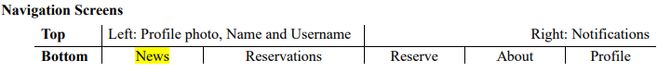
IIMPLEMENTATION STRUCTURE
Screen - Reservations
Screen – Reserve
Screen - About
Screen - Profile
including Cancellation, Changes, and booking
screen serves as the gateway for users to initiate their court booking process.
▪ Privacy Policy
▪ Terms & Conditions
▪ Cancellation Policy
▪ FAQ
▪ Contact Us
▪ Support
▪ Personal Information
▪ Change Password
▪ Notification Settings
▪ Payment Methods – With default selection.

Slide 8

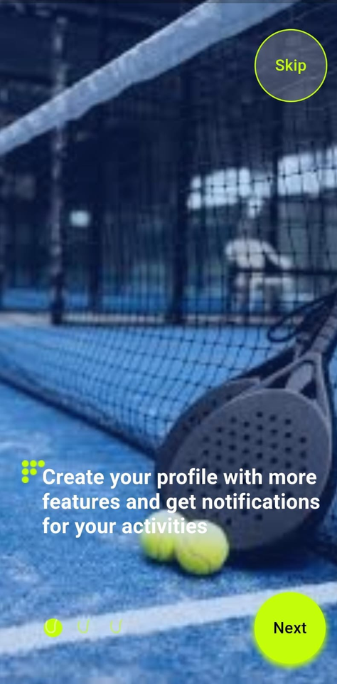
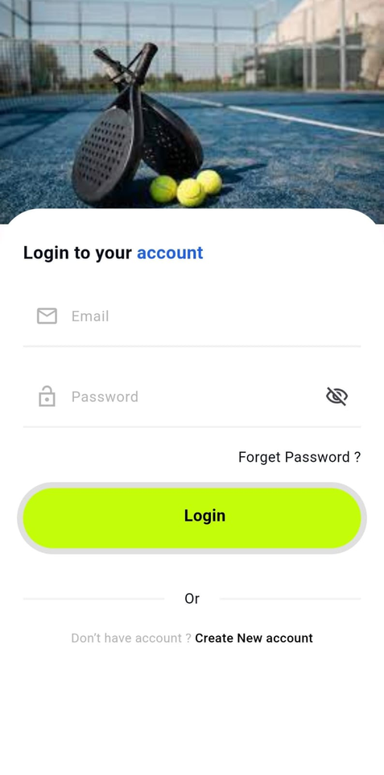
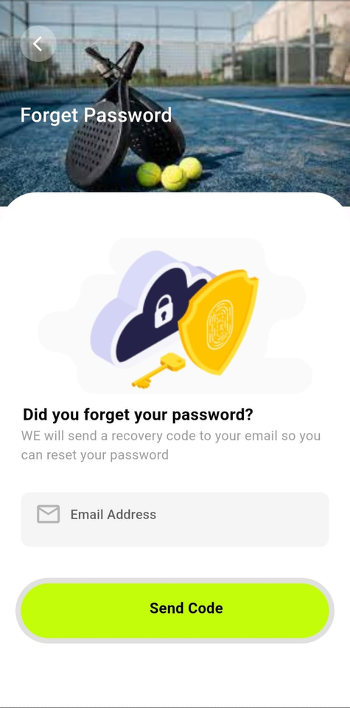
APP DESIGN AND SOME FLOW
Intro Screen
Splash Screen/s
Login
Forget Password

Slide 9
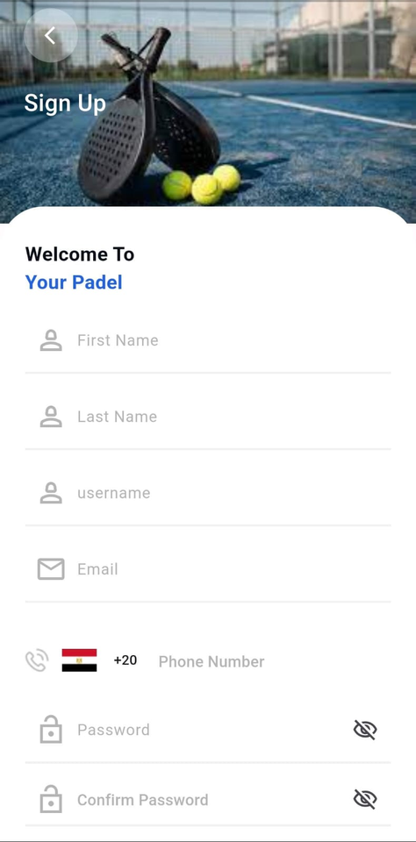
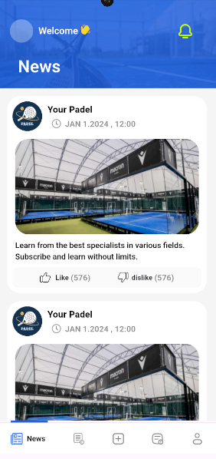
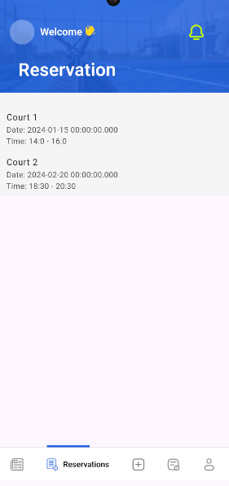
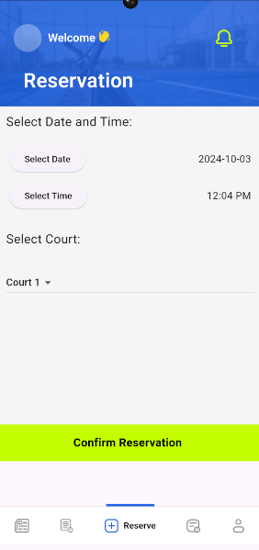
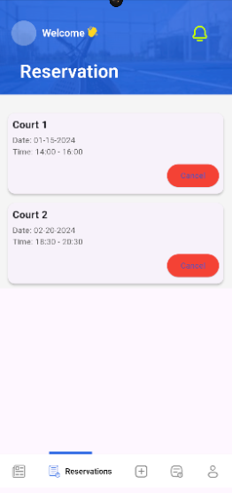
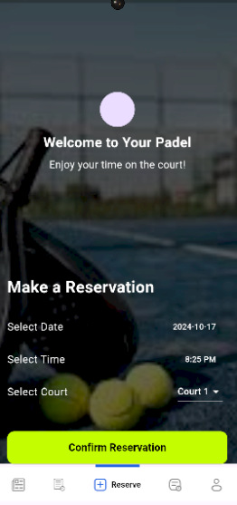
APP DESIGN AND SOME FLOW
Sign UP
News
Reservation
Reserve

Slide 10
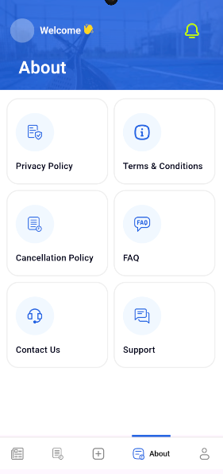
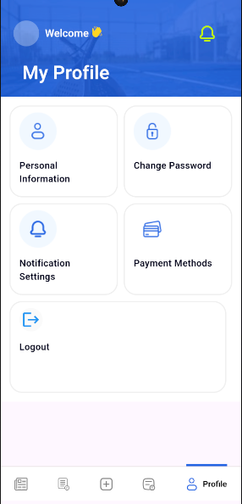
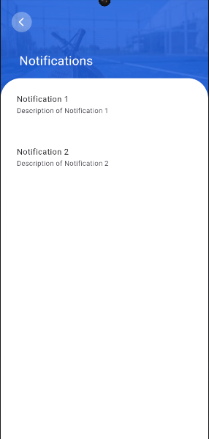
APP DESIGN AND SOME FLOW
About
My Profile
Notifications

Slide 11






MEET THE TEAM
Thank you for your time! Reach out to us for questions.
MOHAMED
MAGDY
MOAAZ ALDAKAR
SHAHD
RHOMA
MAAB
ASHRAF
MOHAMED
MAJID
ROWAIDA MOHAMMED
Flutter Developer
Web developer
Mobile app developer
Mobile App developer
Mobile App developer
Mobile App developer

Slide 12

THANK YOU
for your time and attention
Present by WE(DEPI)

